Slide 1


Dealing with Uncertainties in Availability Models using Fuzzy Logic and Neural Networks
POLITECNICO DI MILANO
School of Industrial and Information Engineering
Computer Science and Engineering (CSE) – Master Degree
Department of Electronics, Information and Bio-engineering (DEIB)
Dealing with Uncertainties
in Availability Models using
Fuzzy Logic and Neural Networks
SUPERVISOR: Raffaela Mirandola
CO-SUPERVISOR: Diego Pérez Palacín (Affiliation: Linnaeus University, Sweden)
Academic Year: 2016/2017
Discussion Date: 21/12/2017
STUDENT: Francesco Marchesani (Mat. 852444)
POLITECNICO DI MILANO

Slide 2

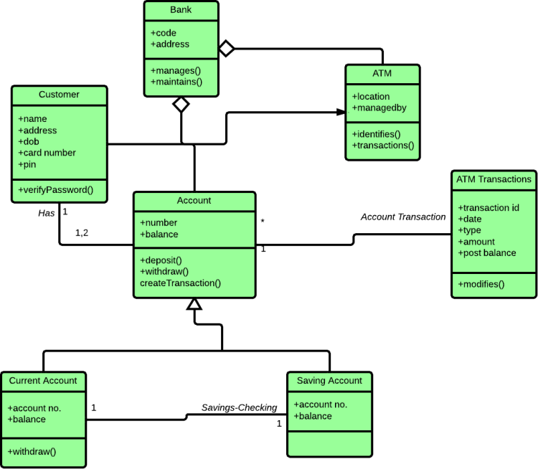

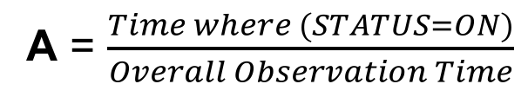
Uncertainty in Model based Software Engineering
Dealing with Uncertainties in Availability Models using Fuzzy Logic and Neural Networks
Our goal is to investigate the impact of uncertainty regarding the system availability considering a model-based approach.
Is it the
correct
model?
?
?
?
?
A = $\frac{Time where (STATUS=ON)}{Overall Observation Time}$
POLITECNICO DI MILANO

Slide 3
Uncertainty in Model based Software Engineering
Dealing with Uncertainties in Availability Models using Fuzzy Logic and Neural Networks
Traditional availability computation methods do not include explicitly sources of uncertainty in the computation.
Our proposal is to add an ‘uncertainty layer’ to the analysis, importing approaches from other fields.
We will focus explicitly on Artificial Intelligence techniques as Fuzzy Logic and Neural Networks.
What can be the impact of
uncertainty on the Availability?
POLITECNICO DI MILANO

Slide 4
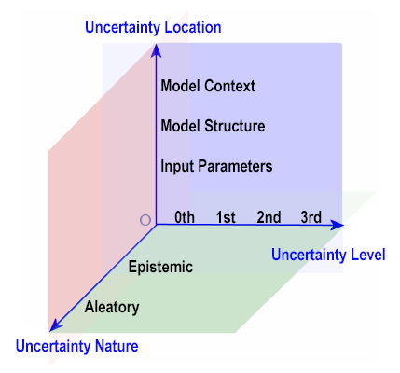
Source of Uncertainty in Models (Taxonomy)
Dealing with Uncertainties in Availability Models using Fuzzy Logic and Neural Networks
We will focus on this Uncertainty Dimension!
Location Uncertainty
Model Context
Model Structure
Input Parameters
POLITECNICO DI MILANO

Slide 5
Location Dimension & Uncertainty
Dealing with Uncertainties in Availability Models using Fuzzy Logic and Neural Networks
Location Uncertainty
Model Context
Model Structure
Input Parameters
POLITECNICO DI MILANO

Slide 6
Location Dimension & Uncertainty
Dealing with Uncertainties in Availability Models using Fuzzy Logic and Neural Networks
This dimension is related to the specific Location of uncertainty in the considered model. It has three subclasses: Context, Structural and Input Parameters Uncertainty.
Input Parameters Uncertainty: it is related to the input parameters of the model with their degree of uncertainty (for example with respect to the methods used for parameters calibration or different types of errors).
Model Structural Uncertainty: regards the form of the model itself; in practice concerns what kind of model is the more accurate for the specific goals and objectives.
Model Context Uncertainty: it is related to the identification of model’s boundaries, process that aims to specify the part of the real world to be effectively modelled.
POLITECNICO DI MILANO

Slide 7
Uncertainty Sources in Models
Dealing with Uncertainties in Availability Models using Fuzzy Logic and Neural Networks
SOURCE OF UNCERTAINTY | CLASSIFICATION
 | LOCATION | NATURE
Simplifying assumptions | Structural/Context | Epistemic
Model drift | Structural | Epistemic
Noise in sensing | Input Parameters | Epistemic/Aleatory
Future parameters value | Input Parameters | Epistemic
Human in the loop (HITL) | Context | Epistemic/Aleatory
Objectives | Input Parameters/Context | Epistemic
Decentralization | Context/Structural | Epistemic
Execution context/Mobility | Context/ Structural/ Input parameters | Epistemic
Cyber-physical system | Context/ Structural/ Input parameters | Epistemic
Automatic Learning | Structural/Input Parameters | Epistemic/Aleatory
Rapid evolution | Structural/Input Parameters | Epistemic
Granularity of models | Context/Structural | Epistemic
Different sources of information | Input parameters | Epistemic/Aleatory
Table which relates the source of uncertainty in models (and self-adaptive systems) with the dimensions of Location and Nature of the considered taxonomy.
POLITECNICO DI MILANO

Slide 8
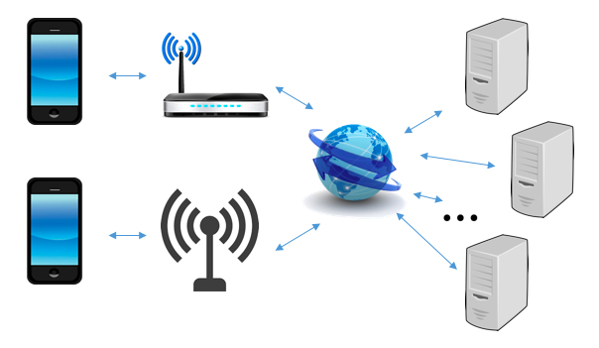
Real World Problem Statement
Dealing with Uncertainties in Availability Models using Fuzzy Logic and Neural Networks
Mobile Device
Access Media
Mobile Device
Internet Connection
3rd Party
Service Providers
Real world data and traces from [Brighten Godfrey, 2010]
POLITECNICO DI MILANO

Slide 9
Fuzzy Logic & Availability (the approach)
Dealing with Uncertainties in Availability Models using Fuzzy Logic and Neural Networks
Sources of Uncertainty
Fuzzy Logic and Integration
Overall Availability Computation
POLITECNICO DI MILANO

Slide 10
Fuzzy Input and Output Variables
Dealing with Uncertainties in Availability Models using Fuzzy Logic and Neural Networks
Input Variables: Measured Availability, Normalized Measure Precision
Output Variable: Input Parameters Availability
Input Variables: Provider Is On Confidence, Providers Dependencies
Output Variable: Model Structure Availability
Input Variables: Predicted Battery Life, Computing Infrastructure Robustness
Output Variable: Model Context Availability
INPUT
PARAMETERS
MODEL
STRUCTURE
MODEL
CONTEXT
POLITECNICO DI MILANO

Slide 11
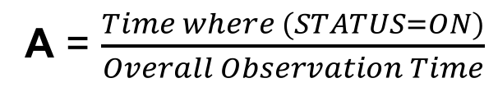
Measured Availability
Dealing with Uncertainties in Availability Models using Fuzzy Logic and Neural Networks
In the following figure are presented the registered availability values (from the reference paper, mapped in the Measured Availability fuzzy variable).
*
SP1 = 0.9929
Antenna = 0.988
Mobile device = 0.9928
SP2 = 0.922
Wi-Fi = 0.077
SP3 = 0.988
For each module:
A = $\frac{Time where (STATUS=ON)}{Overall Observation Time}$
Value ∈ [0,1]
* [D. Perez-Palacin, R. Mirandola, 2014]
POLITECNICO DI MILANO

Slide 12
Suggested approach (Fuzzy Section)
Dealing with Uncertainties in Availability Models using Fuzzy Logic and Neural Networks
Now let us compute the Normalized Measure Precision for the six components (2nd fuzzy variable); these are the input values for each component (to be fuzzyfied).
SP1 = 0.801
Antenna = 0.952
Mobile device = 0.901
SP2 = 0.830
Wi-Fi = 0.673
SP3 = 0.852
“Divide et Impera”
POLITECNICO DI MILANO

Slide 13
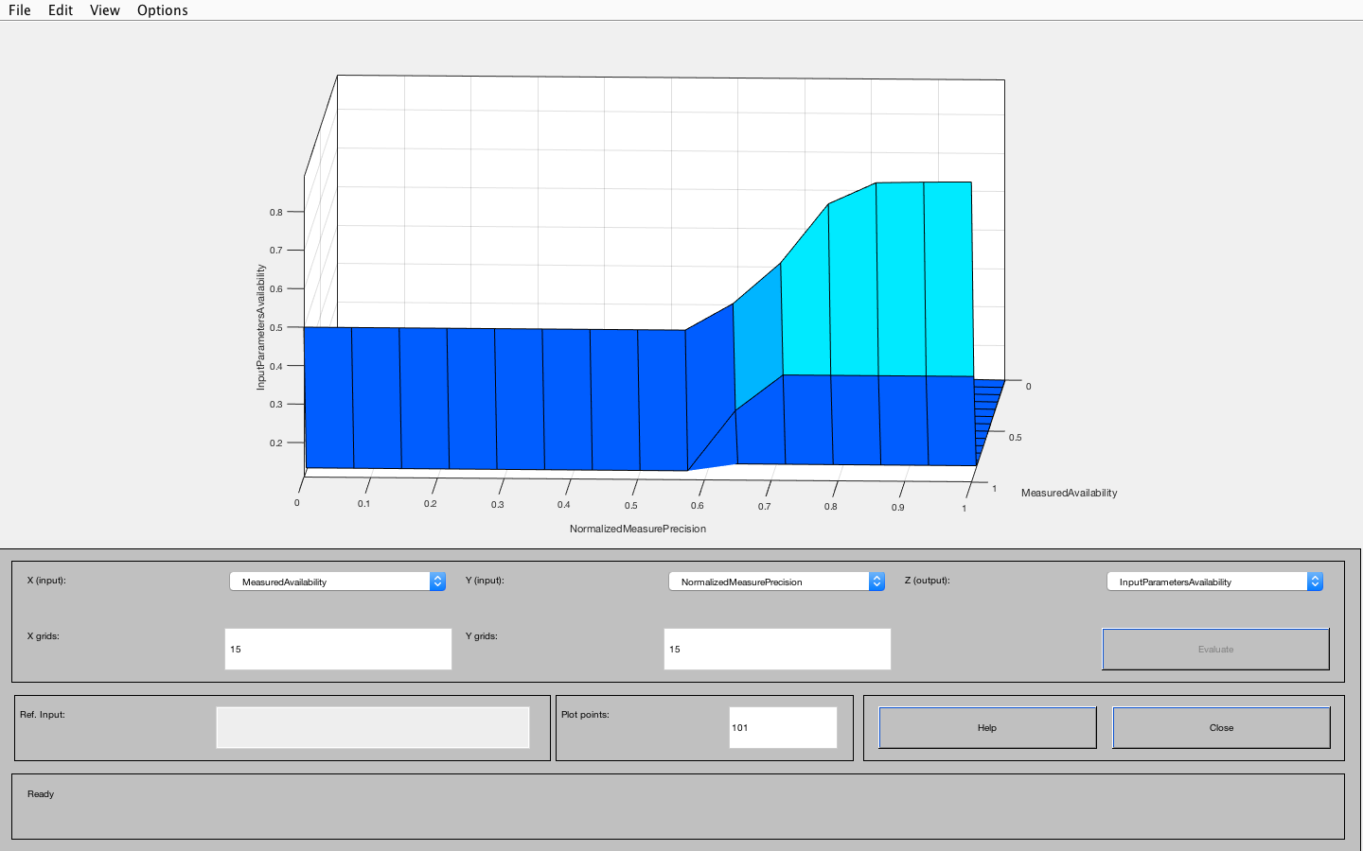
Suggested approach (Fuzzy Section)
Dealing with Uncertainties in Availability Models using Fuzzy Logic and Neural Networks
Now let us compute the Input Parameters Availability for the six components. It considers also the influence of the measure error, with the second fuzzy variable.
SP1 = 0.675
Antenna = 0.808
Mobile device = 0.7804
SP2 = 0.406
Wi-Fi = 0.067
SP3 = 0.606
N.B. With the Fuzzy logic approach we have INPUT PARAMETERS
AVAILABILITY = 0.592, with membership Normal = 0.91
POLITECNICO DI MILANO

Slide 14
Suggested approach (Fuzzy Section)
Dealing with Uncertainties in Availability Models using Fuzzy Logic and Neural Networks
According the model structure section, let us analyze the confidence that a provider is ON:
SP1 = 0.99
Antenna = ///
Mobile device = ///
SP2 = 0.95
Wi-Fi = ///
SP3 = 0.76
POLITECNICO DI MILANO

Slide 15
Suggested approach (Fuzzy Section)
Dealing with Uncertainties in Availability Models using Fuzzy Logic and Neural Networks
Then let us consider the dependence between the access media providers (second fuzzy variable).
SP1 = ///
Antenna = 0.19507
Mobile device = ///
SP2 = ///
Wi-Fi = 0.19507
SP3 = ///
POLITECNICO DI MILANO

Slide 16
MODEL STRUCUTURE AVAILABILITY
Dealing with Uncertainties in Availability Models using Fuzzy Logic and Neural Networks
Now in order to compute the
updated availability in the boxes and
have feasible crisp numbers
we can do something like:
A = A_{INPUT_PARAMETERS} x ProviderIsOnConfidence
_{For the service providers and}
A = A_{INPUT_PARAMETERS} x (1 – ProvidersDependecies)
For the access media
See next slide for the updated availability values
_{(regarding} _{the involved modules)}
POLITECNICO DI MILANO

Slide 17
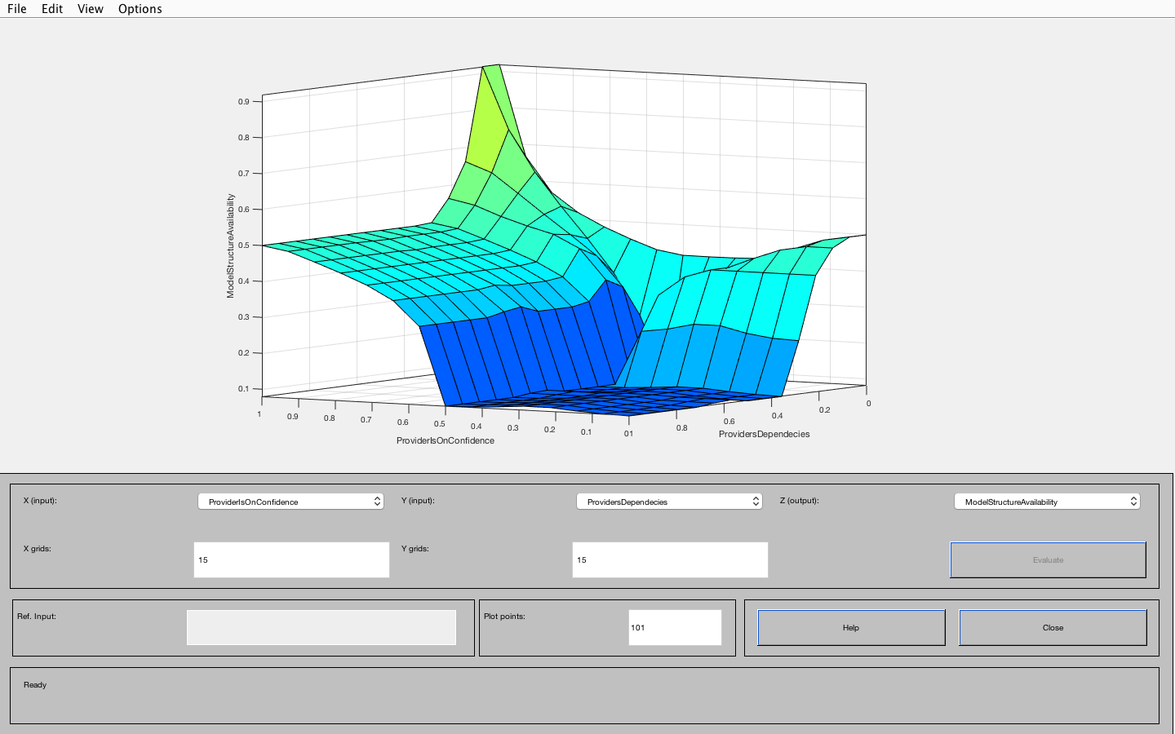
Suggested approach (Fuzzy Section)
Dealing with Uncertainties in Availability Models using Fuzzy Logic and Neural Networks
Now let us compute the updated availability consider the Model Structure for the six components.
SP1 = 0.66825
Antenna = 0.650
Mobile device = 0.7804
SP2 = 0.3857
Wi-Fi = 0.05393
SP3 = 0.46056
POLITECNICO DI MILANO

Slide 18
Suggested approach (Fuzzy Section)
Dealing with Uncertainties in Availability Models using Fuzzy Logic and Neural Networks
Let us compute the impact of the predicted battery life (here we analyze the case with 50% = 0.5):
SP1 = ///
Antenna = ///
Mobile device = 0.5
SP2 = ///
Wi-Fi = ///
SP3 = ///
POLITECNICO DI MILANO

Slide 19
Suggested approach (Fuzzy Section)
Dealing with Uncertainties in Availability Models using Fuzzy Logic and Neural Networks
Regarding the Computing Infrastructure Robustness, we have the computed level of dependence between 3RD party providers:
SP1 = 9.84
Antenna = ///
Mobile device = ///
SP2 = 9.84
Wi-Fi = ///
SP3 = 9.84
POLITECNICO DI MILANO

Slide 20
MODEL CONTEXT AVAILABILITY
Dealing with Uncertainties in Availability Models using Fuzzy Logic and Neural Networks
Now in order to compute the
updated availability in the boxes and
have feasible crisp numbers
we can do something like:
A = A_{INPUT+STRUCTURE} x PredictedBatteryLife
_{For the mobile device and}
A = A_{INPUT+STRUCTURE} x (1 – (Computing Infrastructure Robustness * 0.01))
For the 3rd party providers, the 0.01 coefficient map the parameter in the 0-1 interval
See next slide for the updated availability values (regarding _{the involved modules)}
POLITECNICO DI MILANO

Slide 21
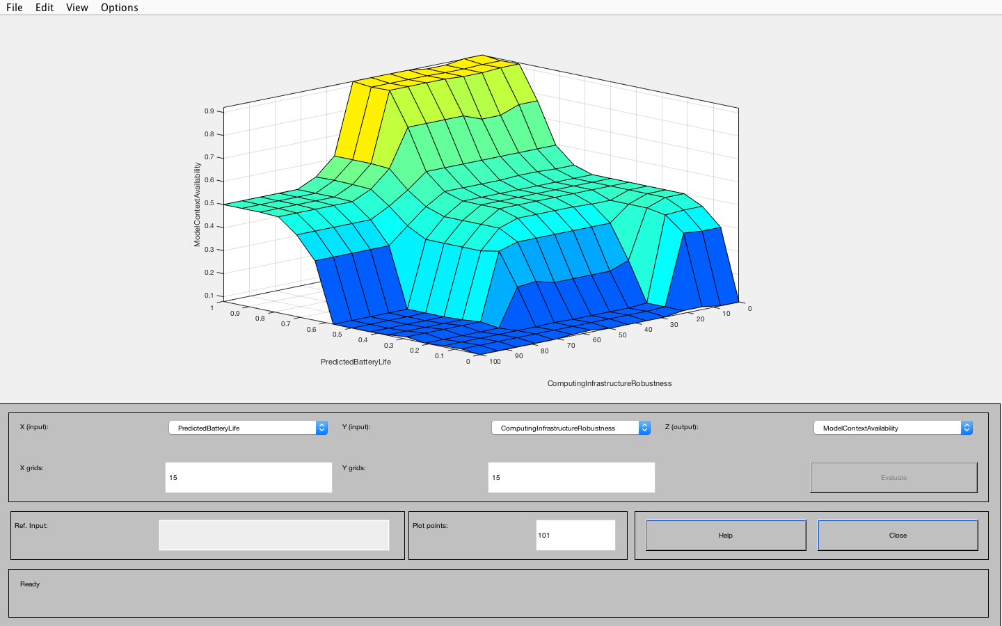
Final Results
Dealing with Uncertainties in Availability Models using Fuzzy Logic and Neural Networks
This final results embodies for each block the influence of the three considered categories of uncertainties and the derived availability.
SP1 = 0.6054
Antenna = 0.650
Mobile device = 0.3902
SP2 = 0.3459
Wi-Fi = 0.05393
SP3 = 0.41726
N.B. With the Fuzzy Logic approach we have χ (CHI) = INPUT PARAMETERS + MODEL STRUCTURE AVAILABILITY + MODEL CONTEXT = 0.5, with membership Normal = 1.
POLITECNICO DI MILANO

Slide 22
Final Results versus Reference Paper
Dealing with Uncertainties in Availability Models using Fuzzy Logic and Neural Networks
Block diagram with availability values after the three filtering phases (with the observed sources of uncertainty) with respect to the ‘standard’ availability (computed in the paper):
SP1 = 0.6054
Antenna = 0.650
It was 0.9929
Mobile device = 0.3902
SP2 = 0.3459
It was 0.988
It was 0.9928
Wi-Fi = 0.05393
It was 0.922
UNCERTAINTY SOURCES
CAN HAVE A CONSIDERABLE
IMPACT!
SP3 = 0.41726
It was 0.077
It was 0.988
POLITECNICO DI MILANO

Slide 23
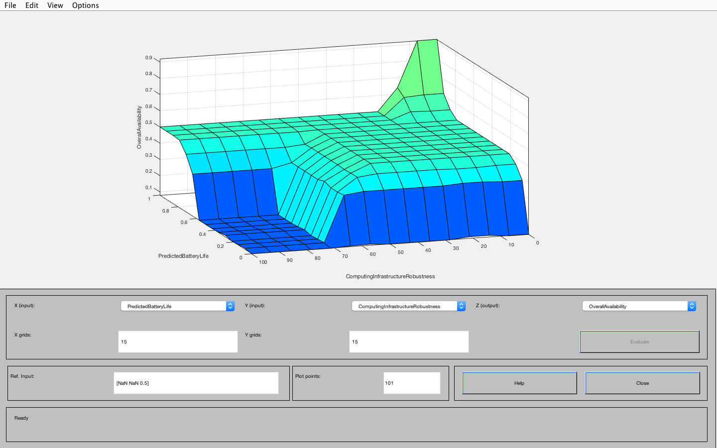
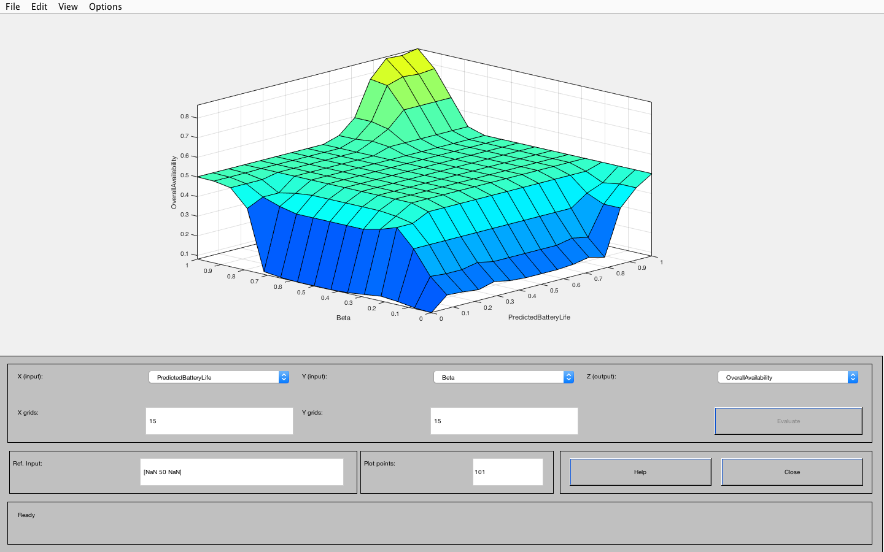
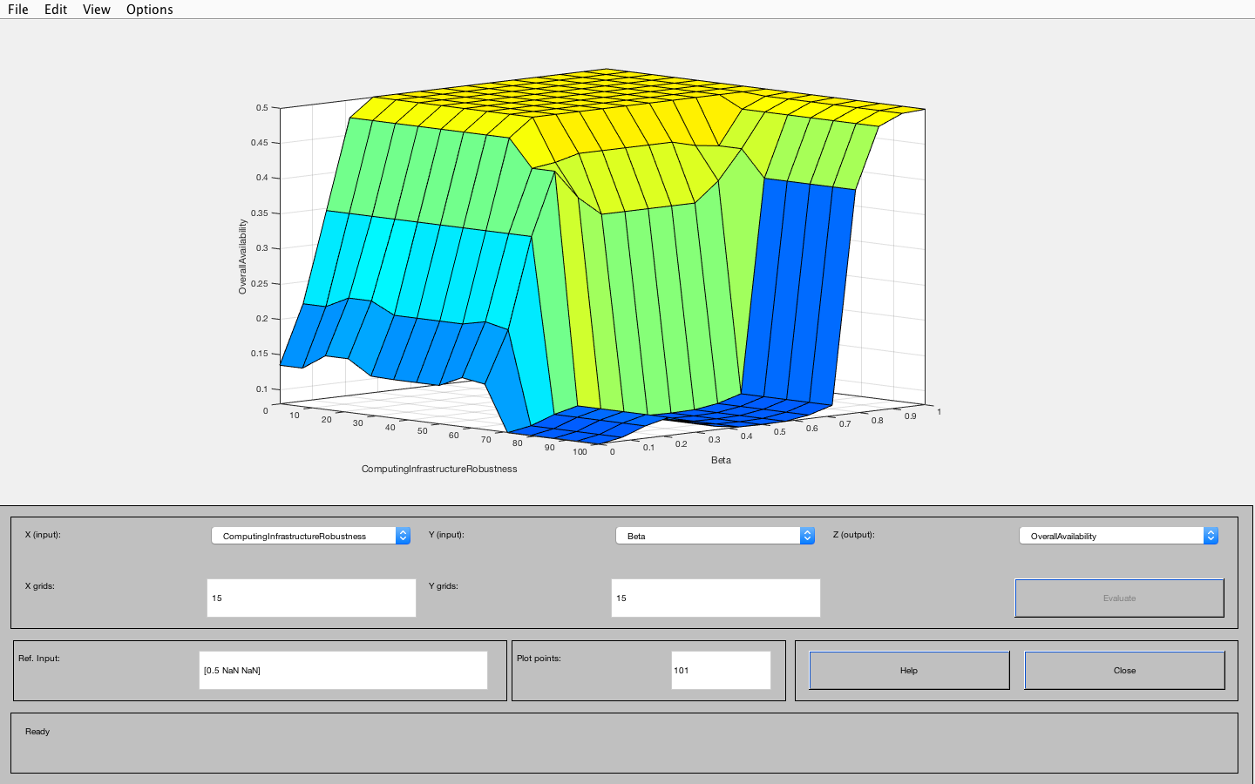
Final Results (Fuzzy Logic)
Dealing with Uncertainties in Availability Models using Fuzzy Logic and Neural Networks
If we compute the availability on this new block diagram (see previous slide) with usual series and parallel rules we obtain an overall availability A = 0.22177. if needed, it can be normalized with a specific technique.
With the Fuzzy waterfall approach instead, and in particular the influence of the Gaussian functions for the output, with crisp values mapped into fuzzy membership functions we obtain A = 0.5 (with fuzzy membership Normal = 1).
N.B. In the original paper A = 0.98
POLITECNICO DI MILANO

Slide 24
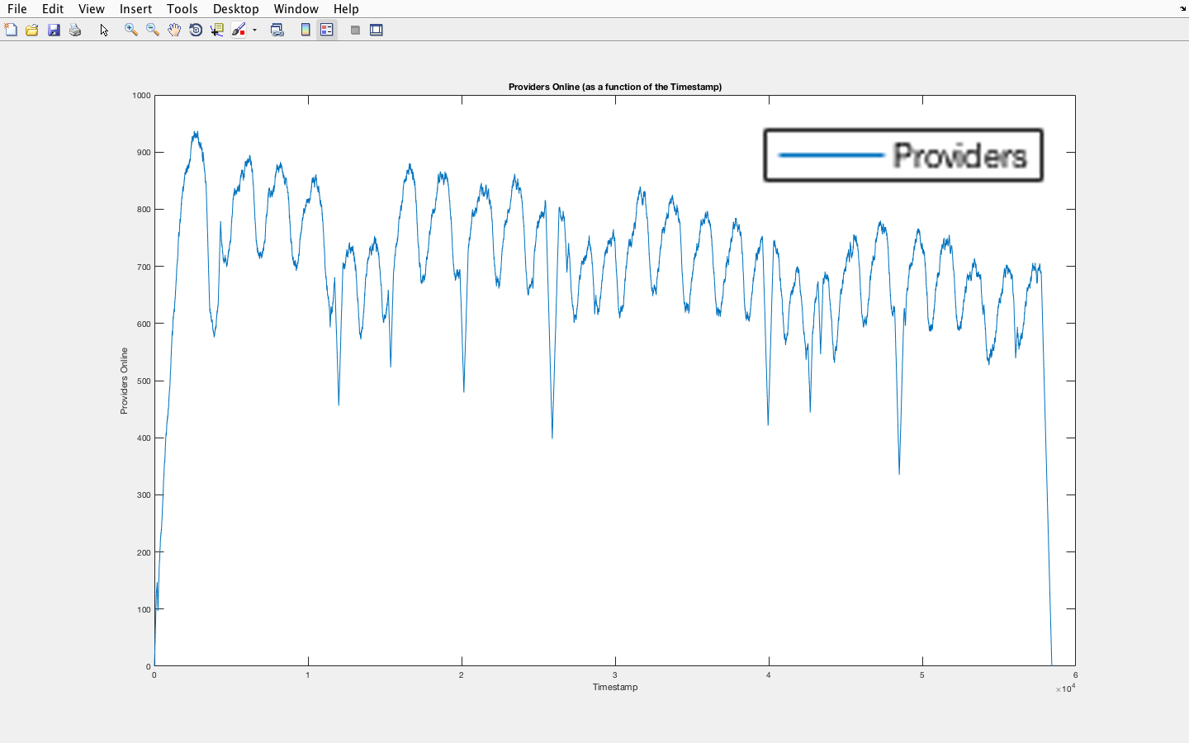
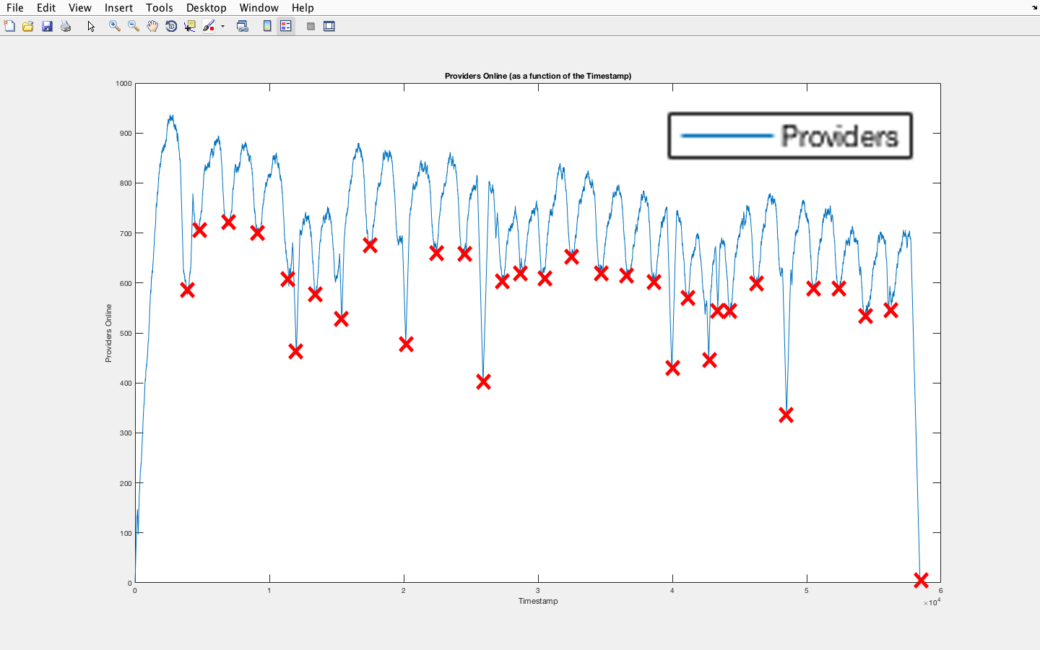
Neural Network for Online Providers’ Prediction
Dealing with Uncertainties in Availability Models using Fuzzy Logic and Neural Networks
GOAL: Predict the future behaviour of the providers…
… and the dependence in their crashes!
NOTE: Data from skype.evt, 1 observation every 45 seconds (the reference TIME UNIT)
POLITECNICO DI MILANO

Slide 25
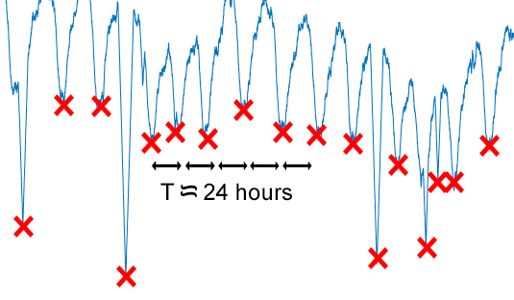

Prelaminar consideration about the dependences
Dealing with Uncertainties in Availability Models using Fuzzy Logic and Neural Networks
Given the structure of the observations, it is easy to deduce that there is on average a local minimum each day: this is likely related to the day-night alternation (with little variance in the weekends, as expected) of online providers, following the users’ demand curve.
…
…
POLITECNICO DI MILANO

Slide 26
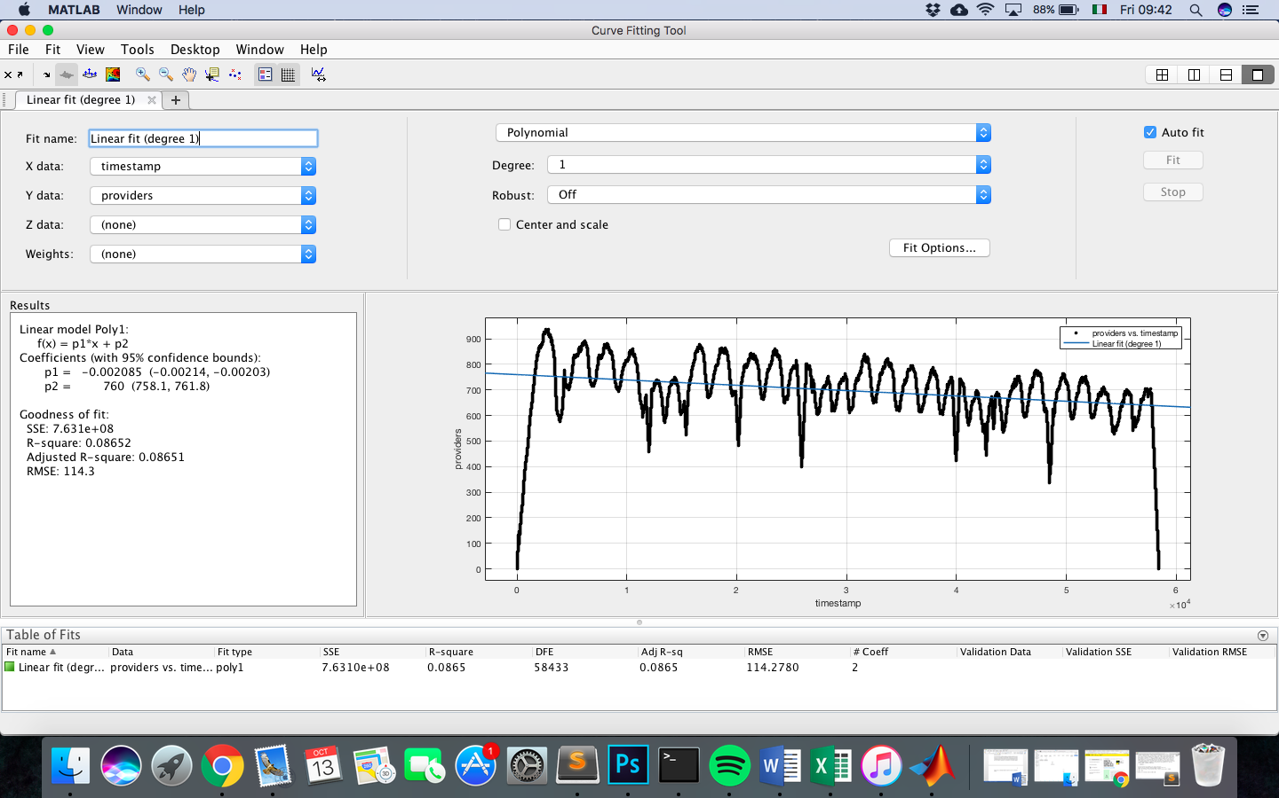
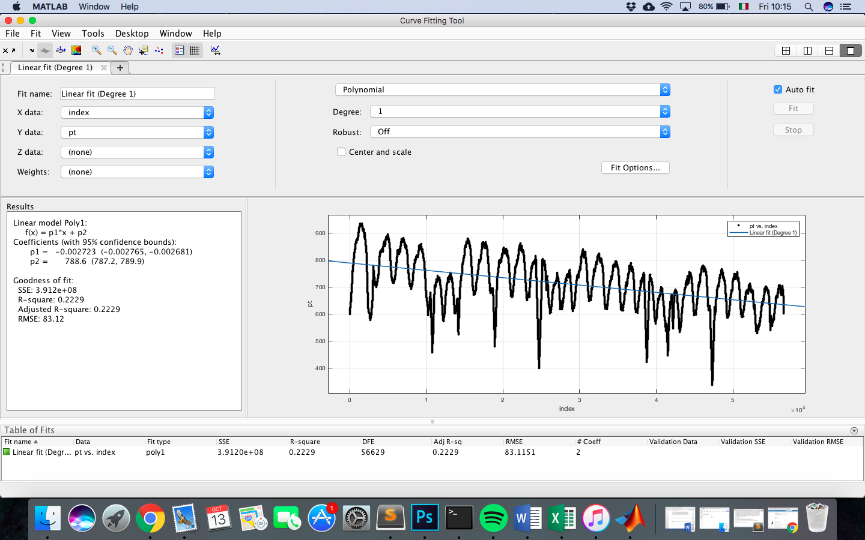
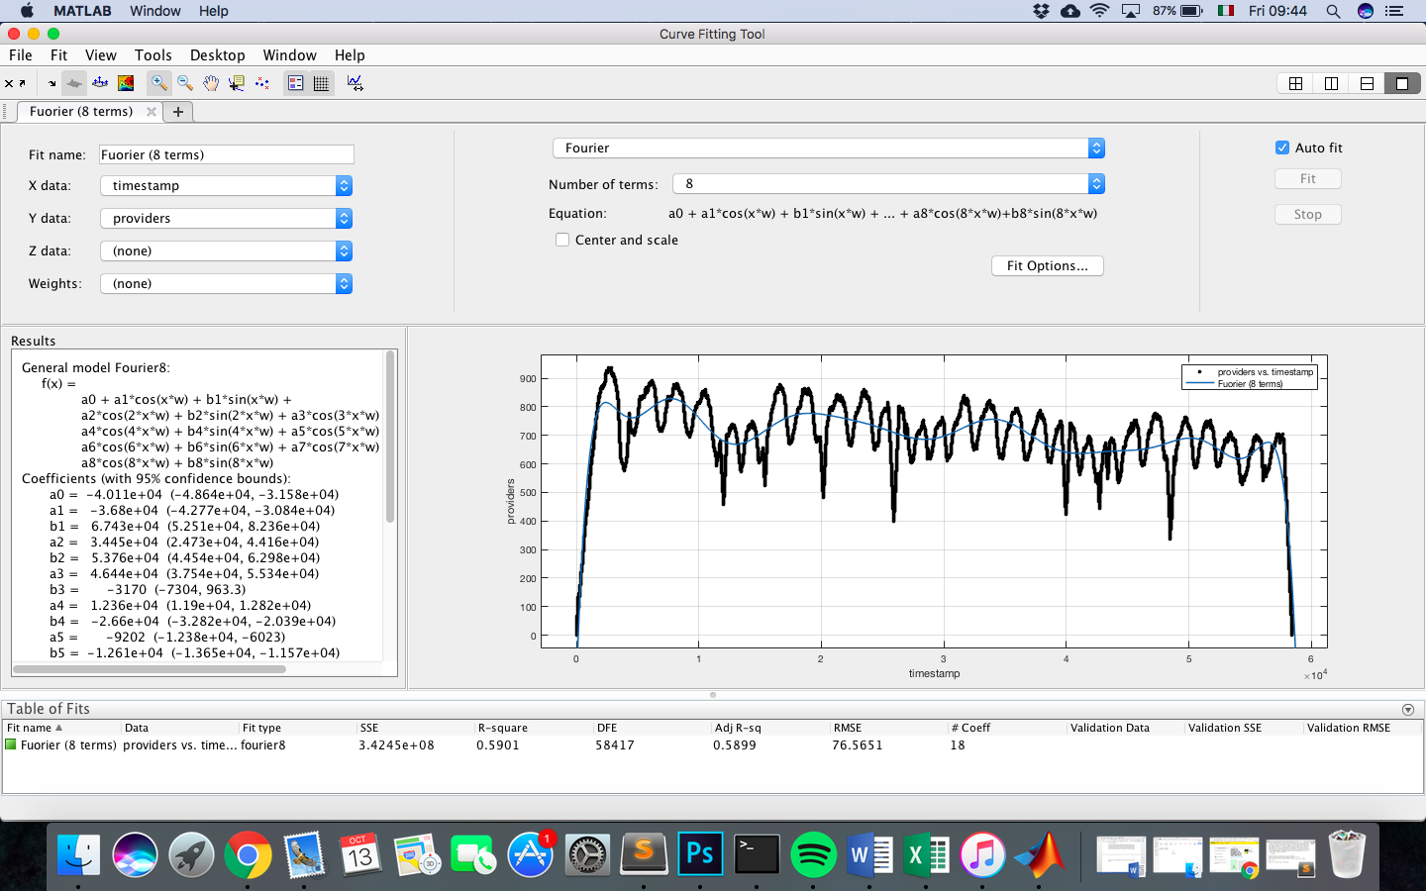
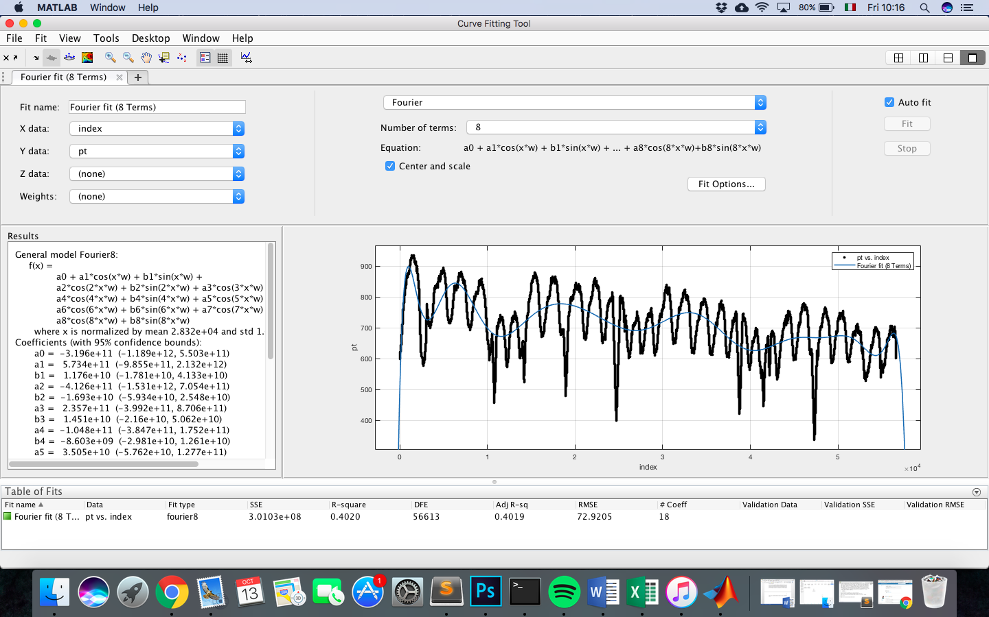
Preliminary Curve Fitting (with and without transient)
Dealing with Uncertainties in Availability Models using Fuzzy Logic and Neural Networks
We tried a classical curve fitting approach as starting point for the analysis:
With Transient:
Without Transient:
Linear Fitting
Linear Fitting
Fourier Fitting (8 terms)
Fourier Fitting (8 terms)
POLITECNICO DI MILANO

Slide 27
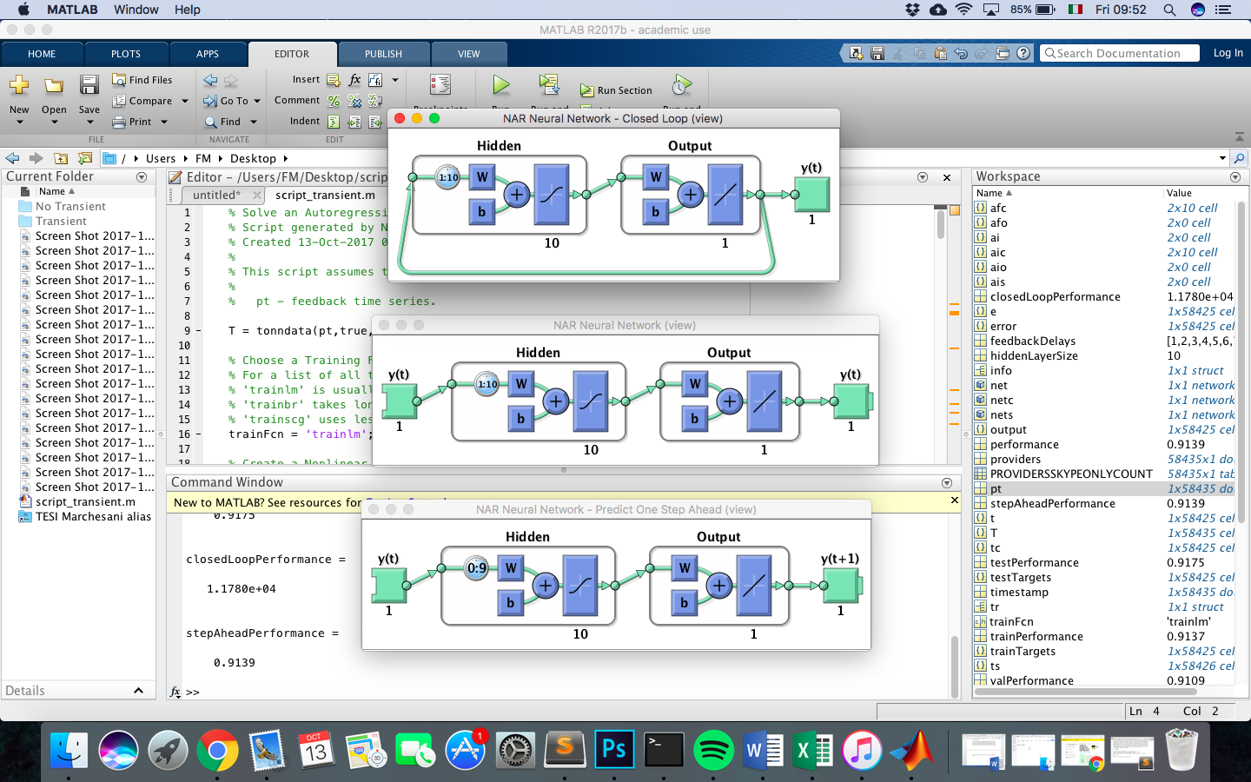
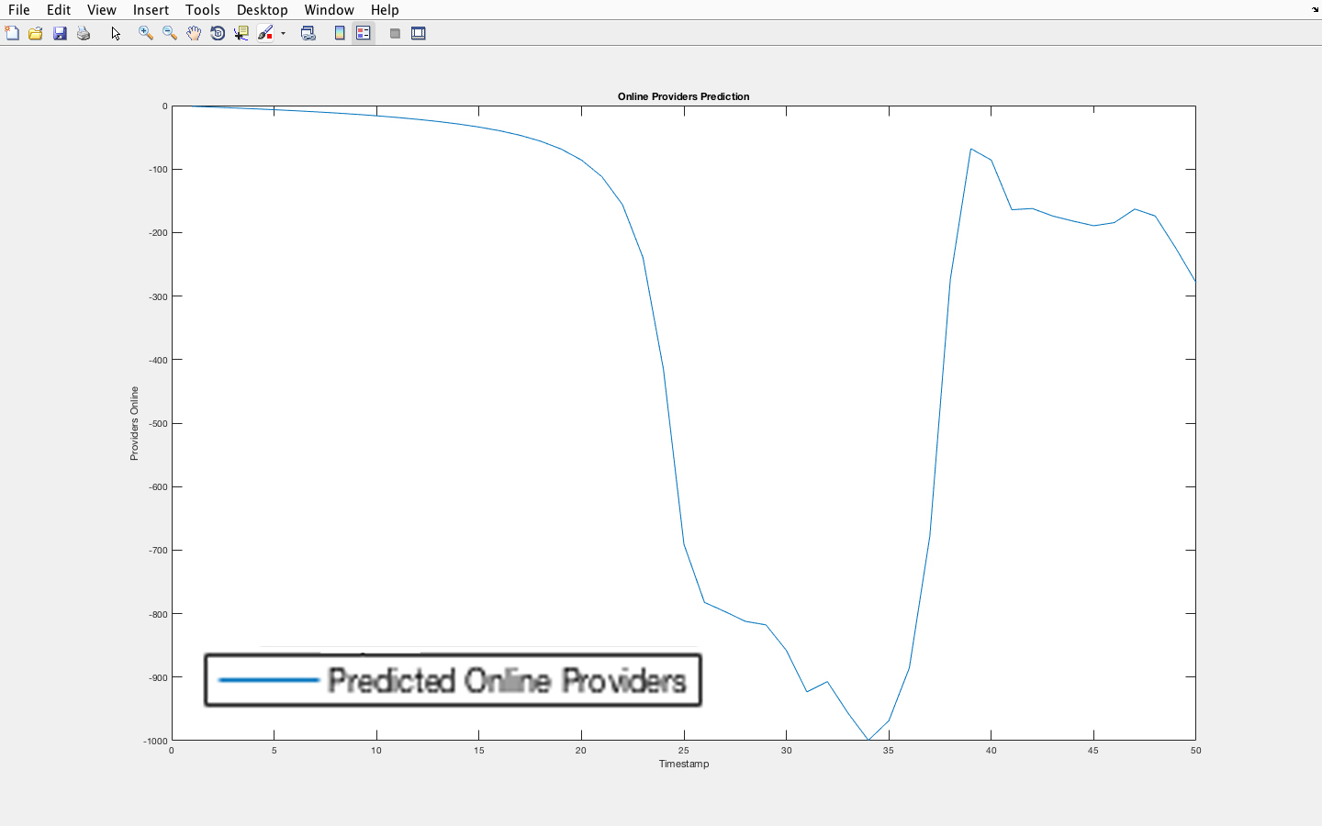
First Neural Network Prediction (with Transient)
Dealing with Uncertainties in Availability Models using Fuzzy Logic and Neural Networks
Neural Network used for Data Prediction
BUT…
NEGATIVE VALUES
FOR THE PROVIDERS!
Predicted Values
POLITECNICO DI MILANO

Slide 28
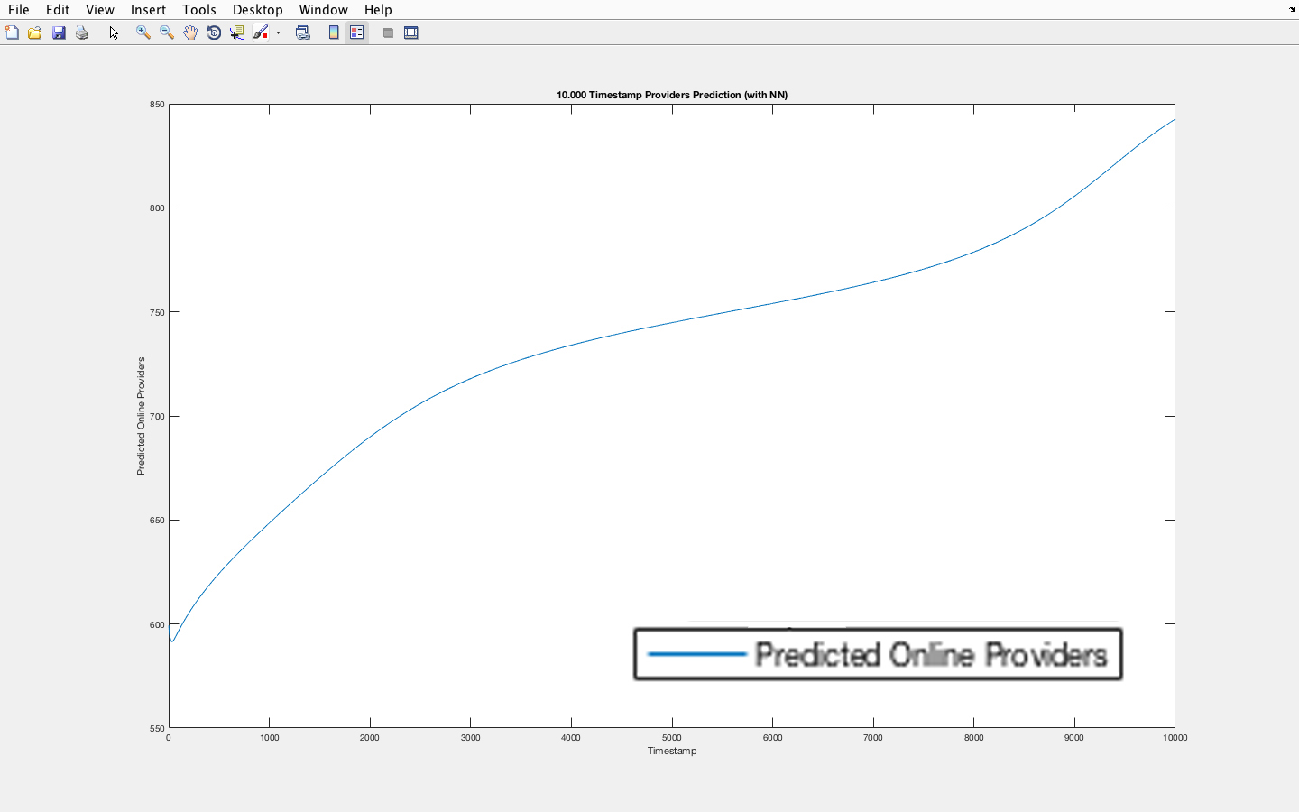
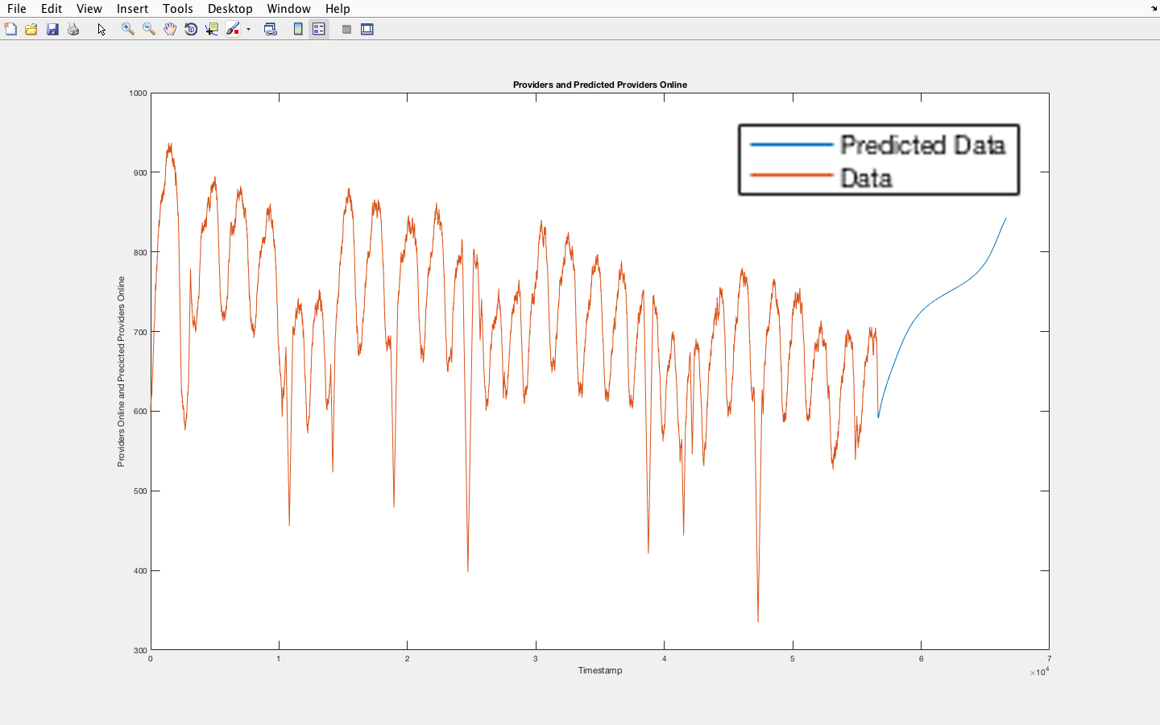
Neural Network Predictions
Dealing with Uncertainties in Availability Models using Fuzzy Logic and Neural Networks
Neural Network (NN1) used for Data Prediction
(NN1)
10 delay units, 10 hidden neurons
Predicted Values
Predicted Values
(with previous values)
With the first NN there is Underfitting: the undulatory behaviour (with the fluctuations) is not captured!
POLITECNICO DI MILANO

Slide 29
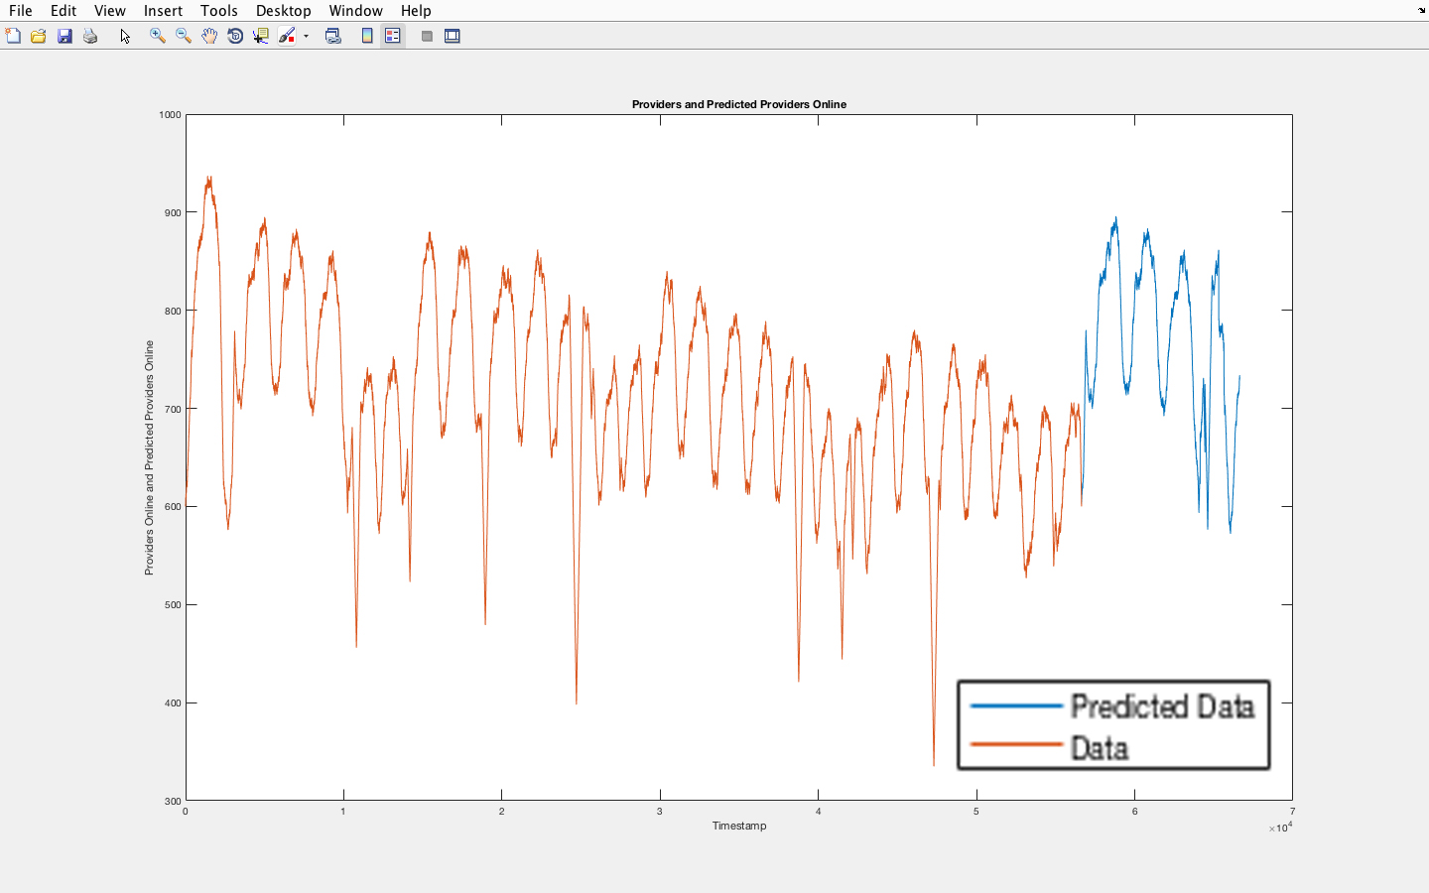
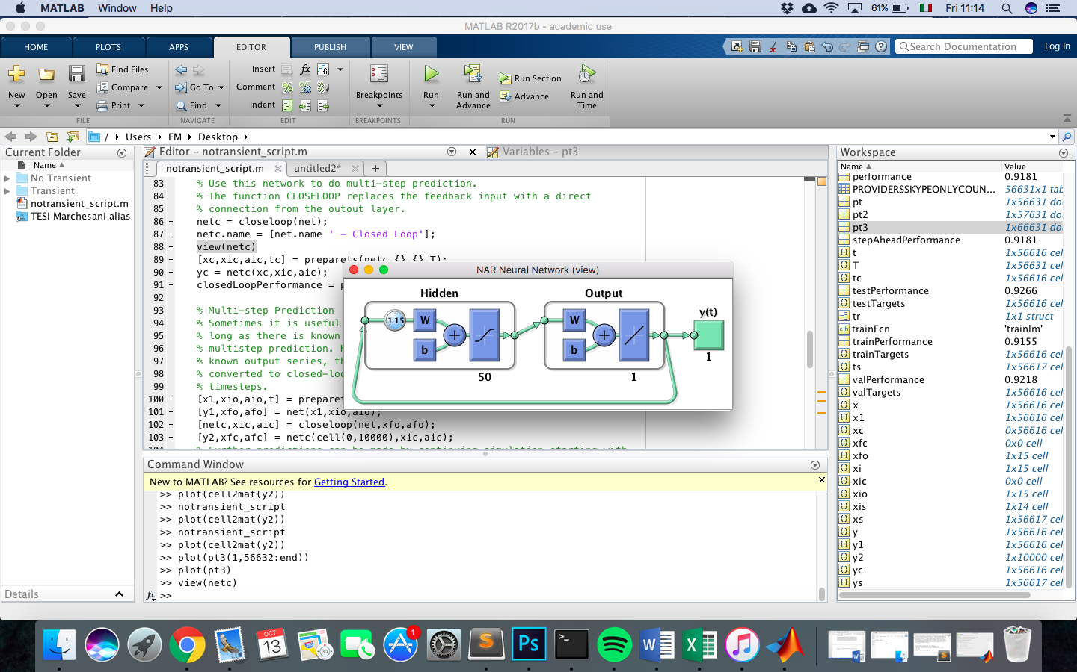
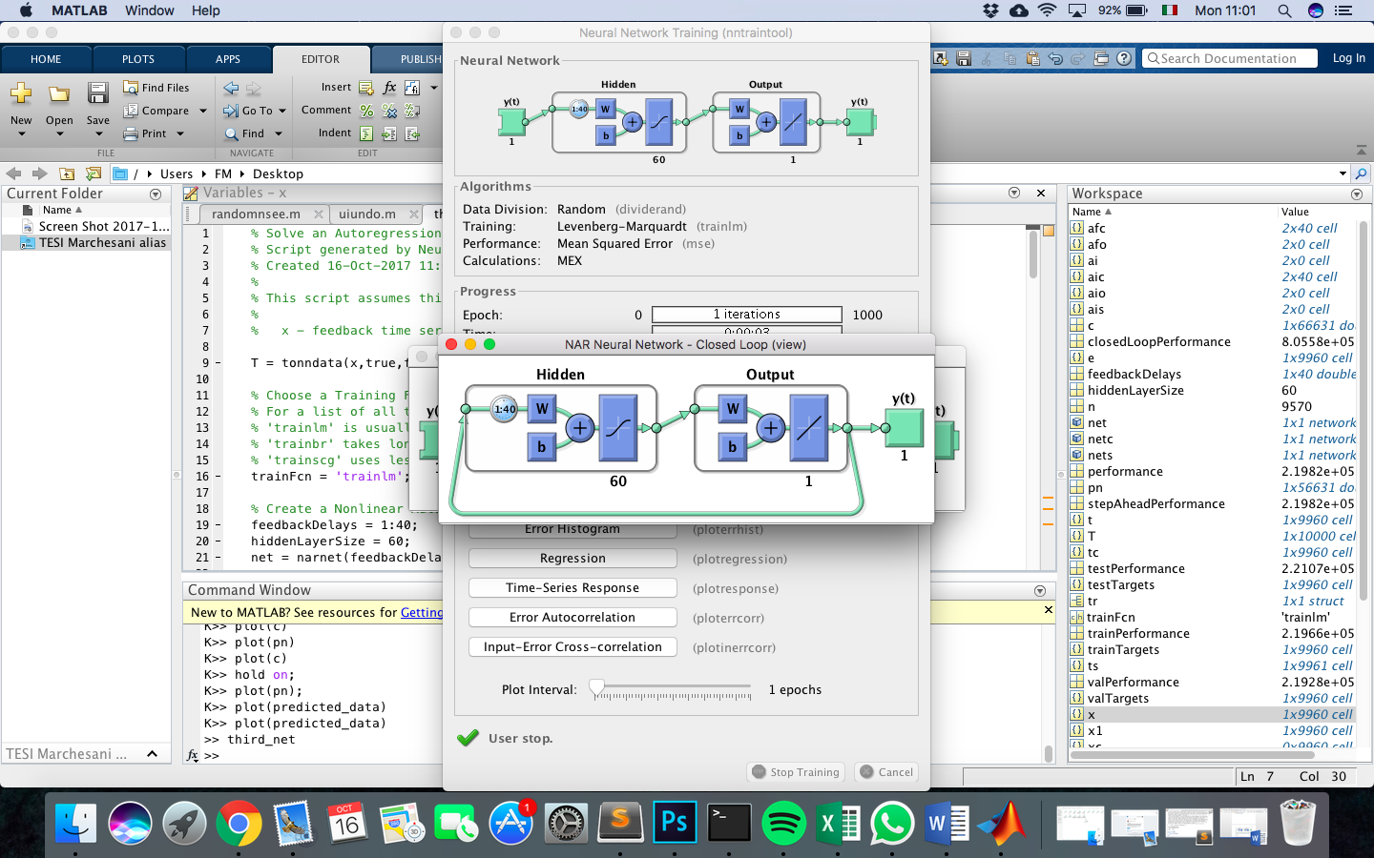
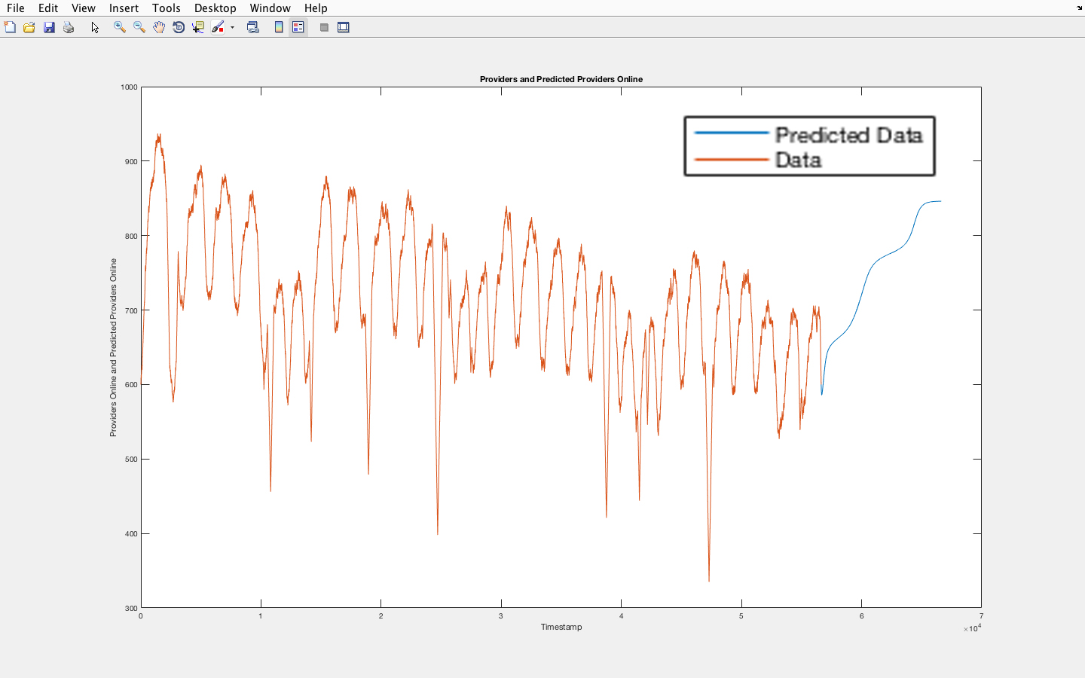
Final Neural Network Predictions (without Transient)
Dealing with Uncertainties in Availability Models using Fuzzy Logic and Neural Networks
Let us try with more complexity …
(NN2)
(NN3)
(NN2) 15 delay units, 50 hidden neurons
(NN3) 40 delay units, 60 hidden neurons
BEST
RESULTS WITH NN3!
Predicted Values (NN2)
Predicted Values (NN3)
POLITECNICO DI MILANO

Slide 30

Conclusions (with some lessons learned)
Dealing with Uncertainties in Availability Models using Fuzzy Logic and Neural Networks
Uncertainty is unavoidable, but there exist handling techniques for its mitigation;
It is possible to estimate the Availability of a system with alternative methods (as Fuzzy Logic), including the influence of uncertainty sources;
Neural Networks can actually make accurate predictions, but parameters tuning and experimentations are needed.
“The only source of
knowledge is experience.”
Albert Einstein
POLITECNICO DI MILANO

Slide 31

Thank you!
Dealing with Uncertainties in Availability Models using Fuzzy Logic and Neural Networks
POLITECNICO DI MILANO

